Slide 1
Message Authentication Code (MAC)

Slide 2
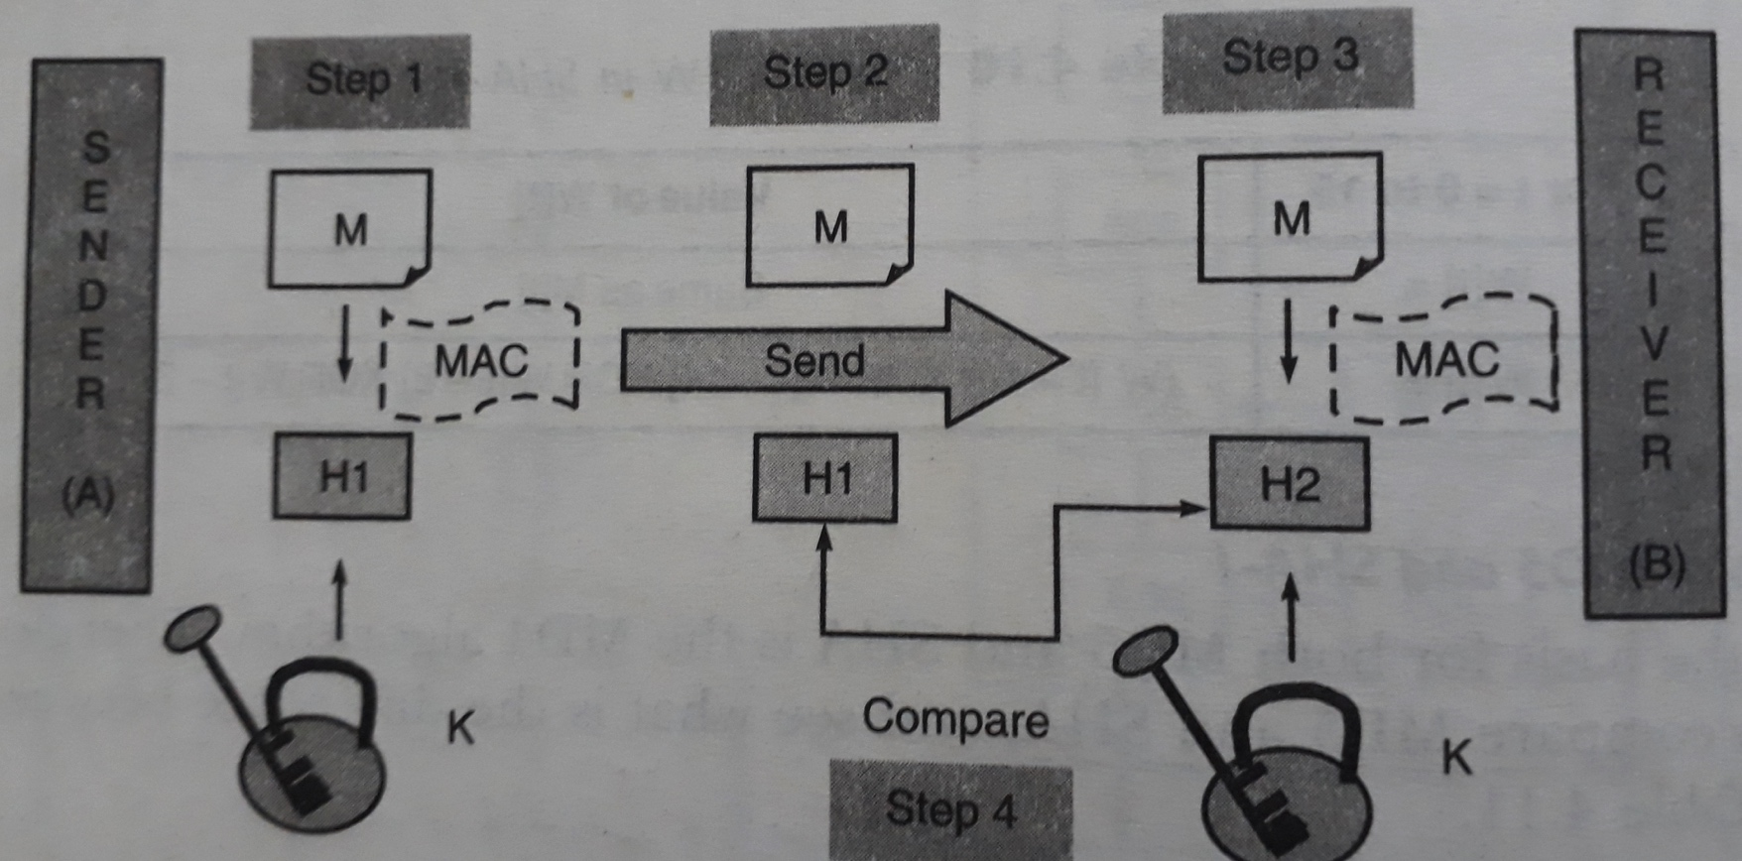
Message Authentication Code (MAC)

Slide 3
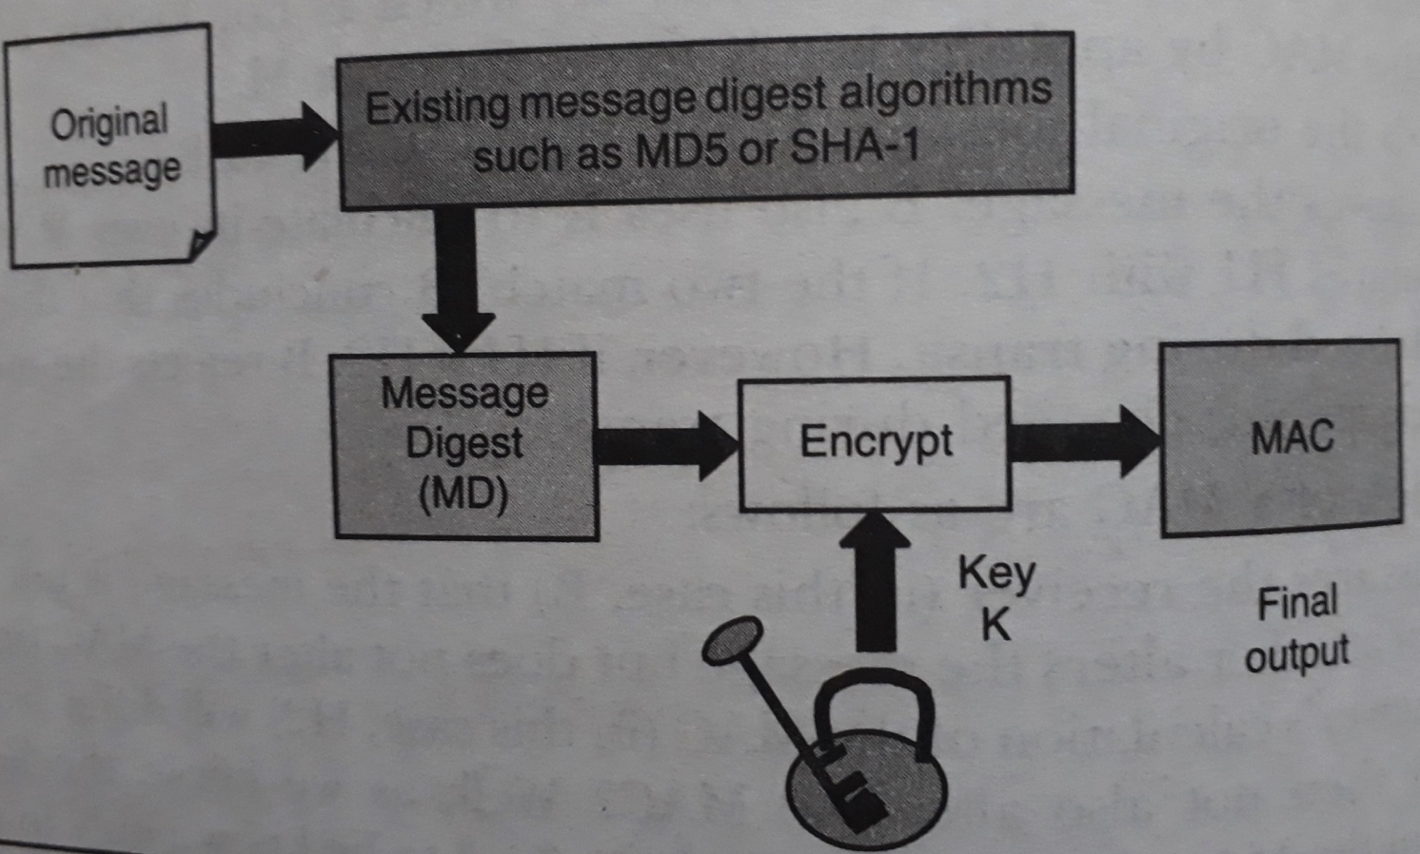
Hash-based Message Authentication Code (HMAC)

Slide 4
Working of HMAC
Variables that will be used in HMAC are as follows:
MD = The message digest / hash function used
M = The input message whose MAC is to be calculated
L = The number of blocks in the message M
b = The number of bits in each block
K = The shared symmetric key to be used in HMAC
ipad = A string 00110110 repeated b/8 times
opad = A string 01011010 repeated b/8 times

Slide 5
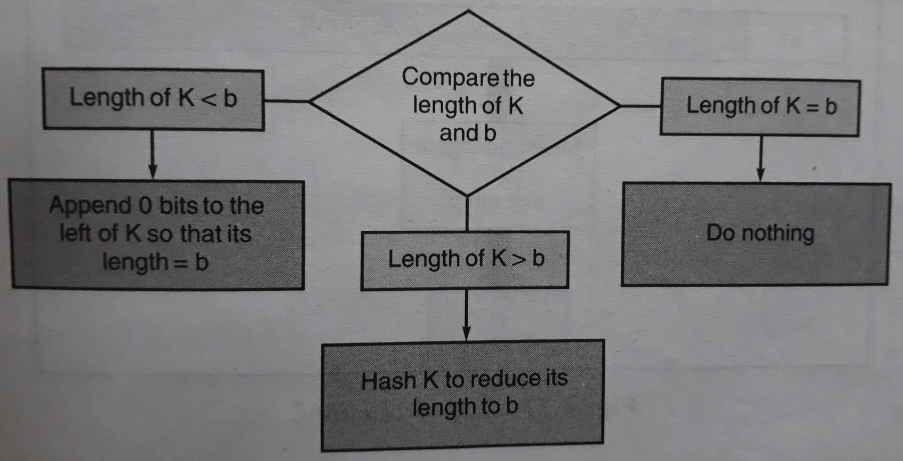
Step 1: Make the length of K equal to b

Slide 6
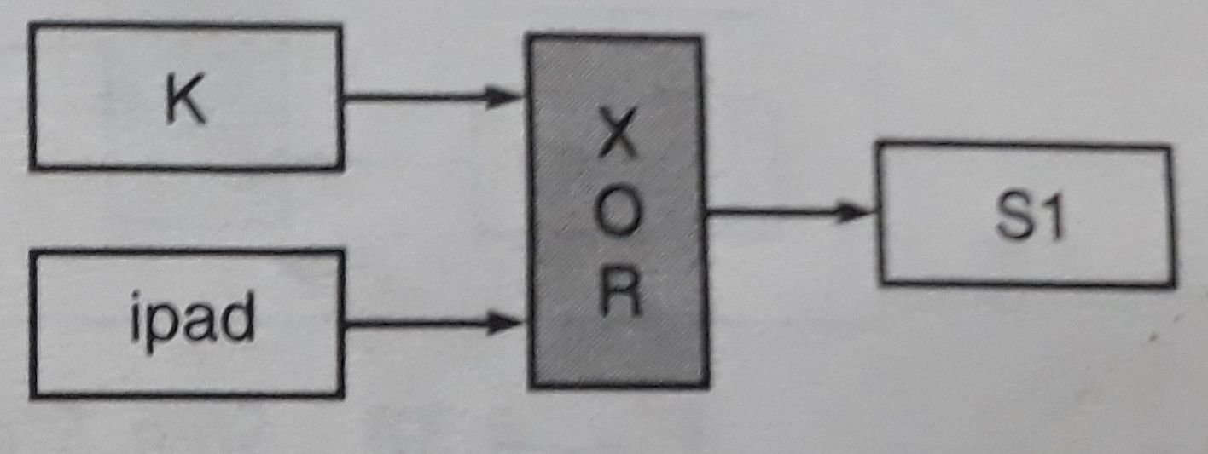
Step 2: XOR K with ipad to produce S1

Slide 7
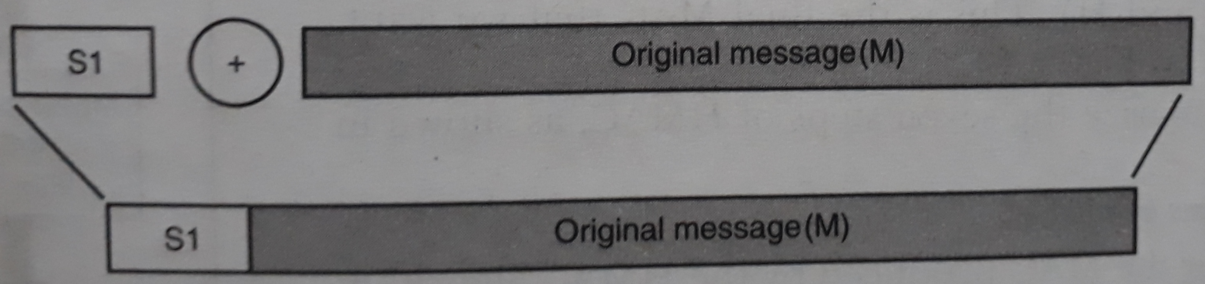
Step 3: Append M to S1

Slide 8
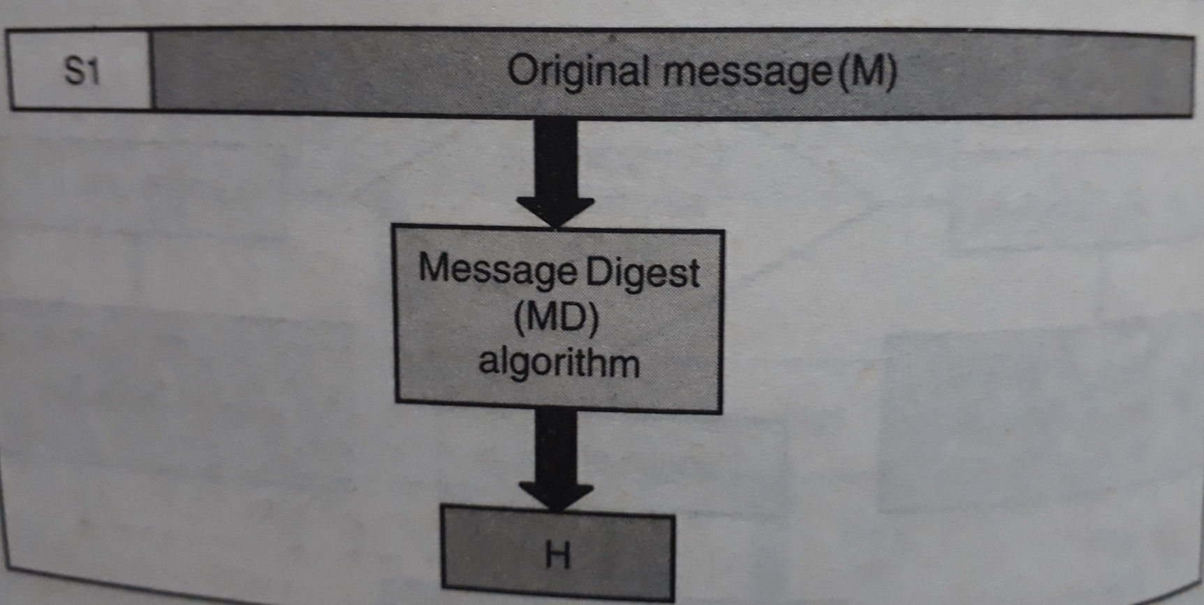
Step 4: Apply MD algorithm

Slide 9
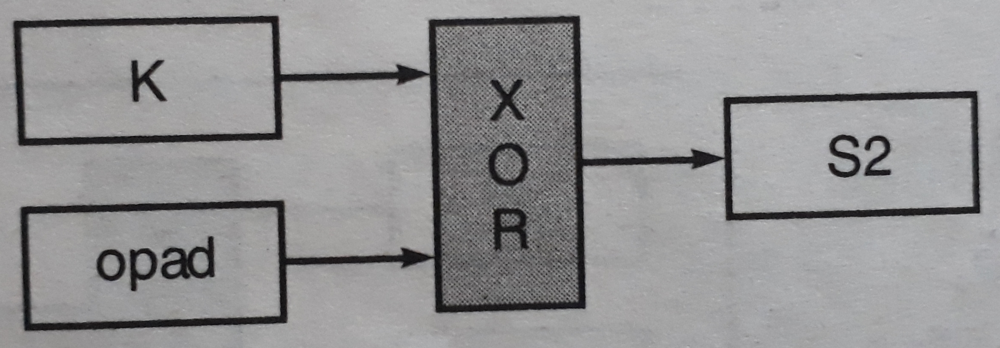
Step 5: XOR K with opad to produce S2

Slide 10
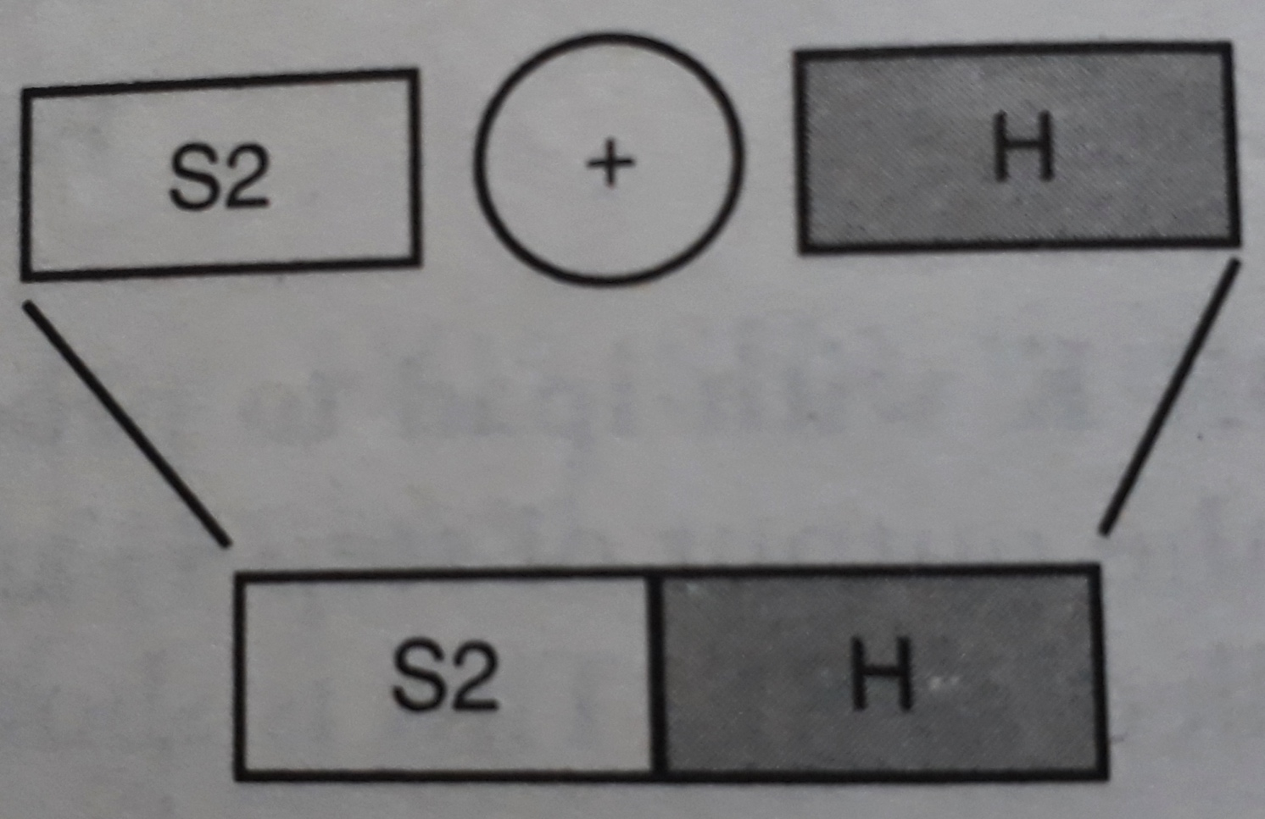
Step 6: Append H to S2

Slide 11
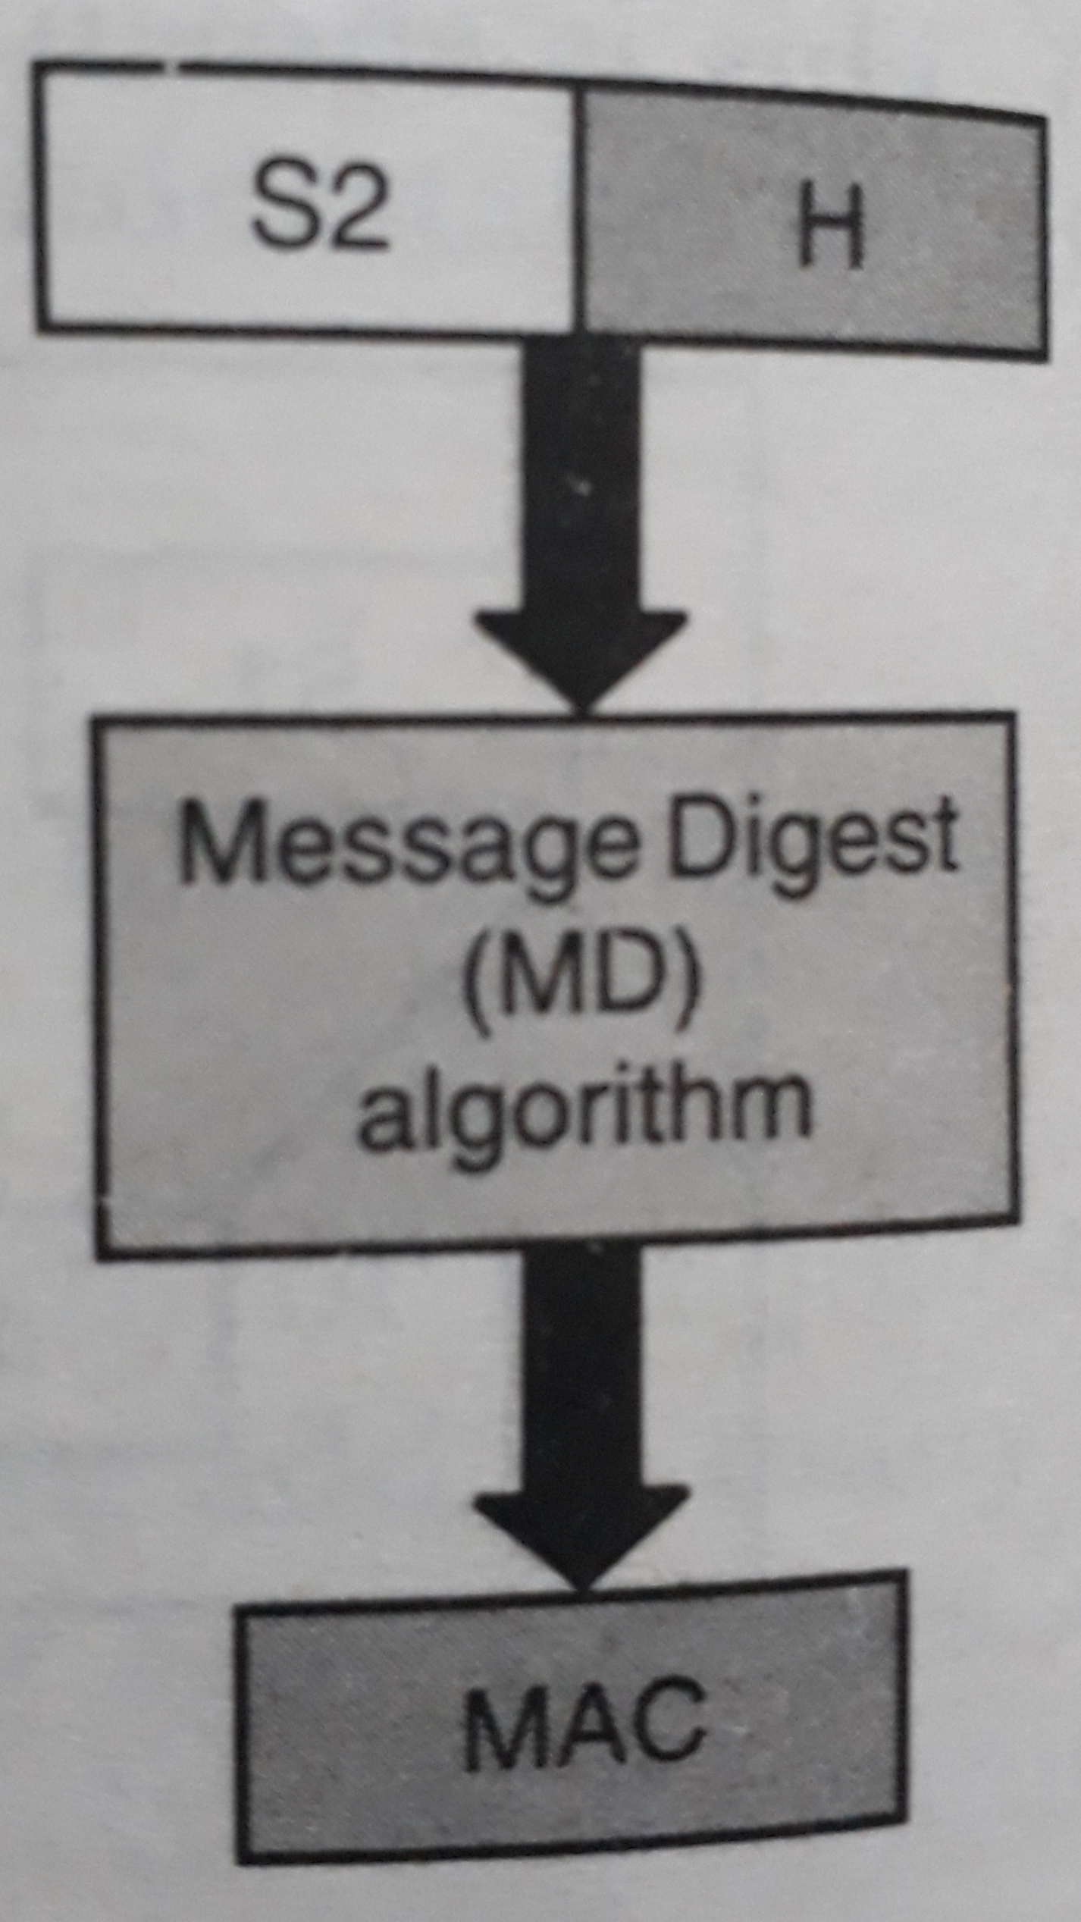
Step 7: Apply message digest algorithm

Slide 12
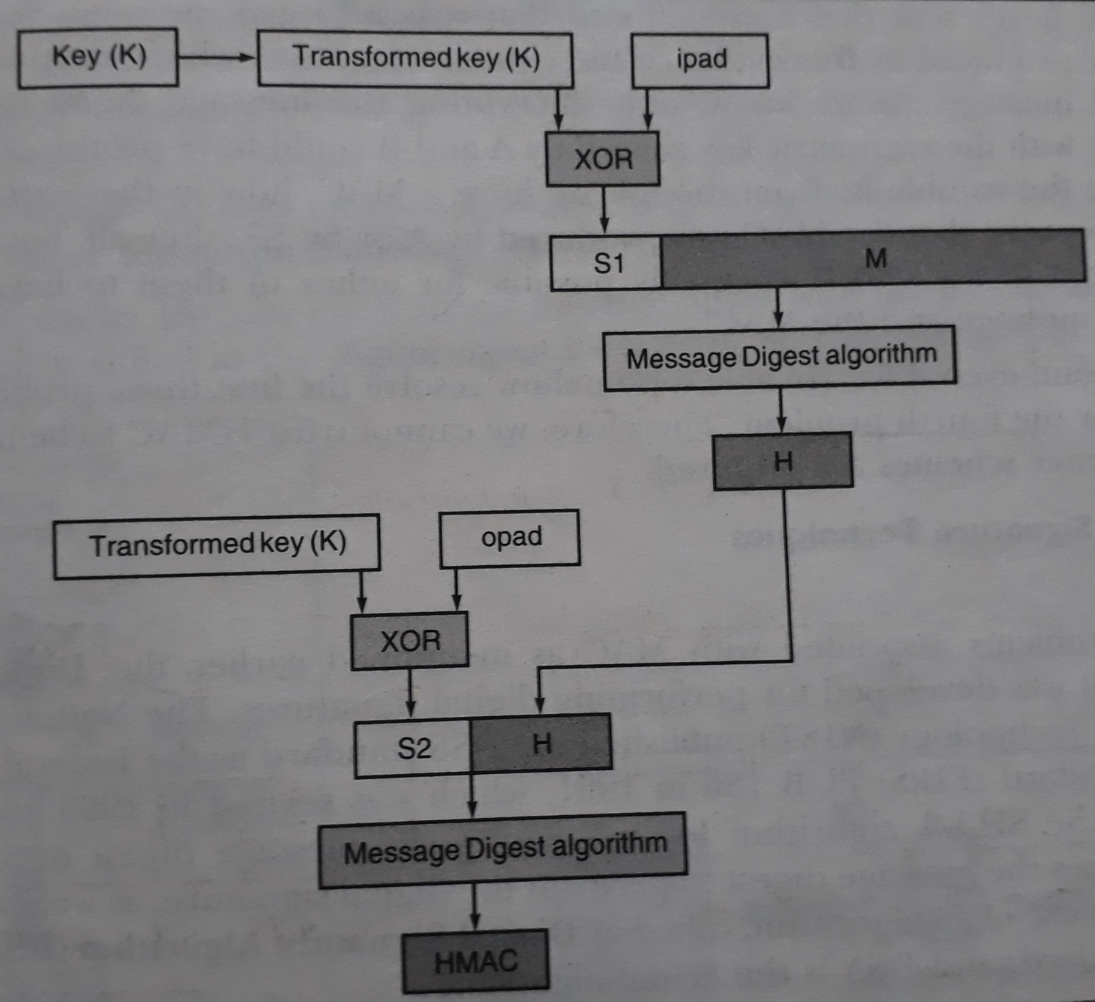
Complete HMAC operation

Slide 13
Disadvantages of HMAC
Problem of Key exchange
How to use a single symmetric key when multiple receivers are there?
Are both the sender and receiver trustworthy?

Slide 14
Topic for Self Study
Digital Signature Algorithm (DSA)

Slide 15
Thank You

